Slide 1
Vrinda Store Data Analysis
EXCEL PROJECT

Slide 2
Objective
Vrinda Store Wants to Create a Sales Report for 2022. So, that Vrinda can understand their customers and grow more sales in 2023.

Slide 3
Questions by Stakeholders
Compare the sales and orders using single chart.
Which month got the highest sales and orders?
Who purchased more- men or women in 2022?
What are different order status in 2022?
List top 5 states contributing to the sales?
Relation between age and gender based on number of orders
Which channel is contributing to maximum sales?
Highest selling category?

Slide 4
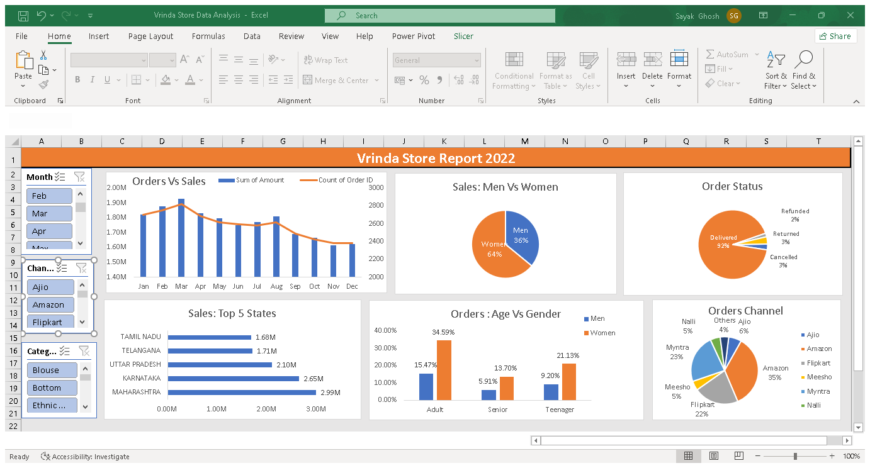

Slide 5
Insights
Women are more likely to buy compared to men (~65%)
Maharashtra , Karnataka and Uttar Pradesh are the top 3 states. (~35%)
Adult age group (30-49 yrs) is max contributing (~50%)
Amazon, Flipkart, Myntra channels are max contributing (~80%)
Final Conclusion to improve Vrinda store sales:
Target women customers of age group (30-49 yrs) living in Maharashtra, Karnataka, Uttar Pradesh by showing ads/offers/coupons available on Amazon, Flipkart and Myntra.

